Slide 1
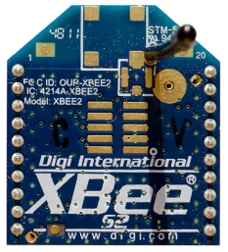
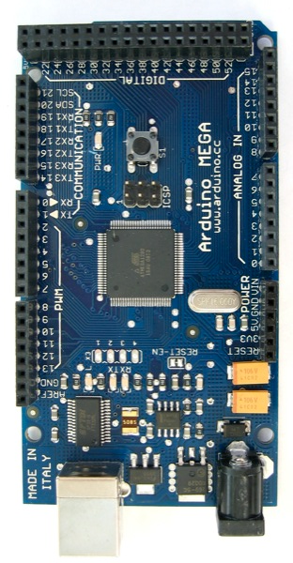
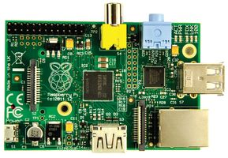
Remote Data Collection using Arduino with Wireless Serial Communication to Raspberry Pi
LM35
5V
Web Base Application With SQLite Database
LM 324
-
+
Wireless Communication
3V
RXD
GND
RXD
TXD
GND
3V

